Slide 1
1. The pastor should spend most of his time…
  a. preparing to teach.
  b. visiting and caring for members of the congregation.
  c. doing evangelism.
  d. running the ministries of the church.
  e. something else.

Slide 2
2. It is more important that the pastor…
  a. always be nice to everyone and make people feel welcome.
  b. hold people accountable to scripture and provoke them to grow spiritually.

Slide 3
3. The one thing the pastor should not do is…
  a. talk to people about how much they financially give to the church.
  b. get involved in decisions about the building.
  c. take a turn cleaning the toilets.
  d. force other ministry leaders to participate in ongoing training.
  e. more than one of the above.
  f. none of the above, the pastor should or may do any of these.

Slide 4
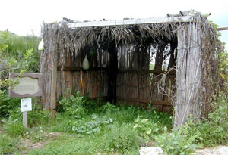
John 7.1-36
Image from heartofwisdom.com

Slide 5
John 7.1 NET: After this Jesus traveled throughout Galilee. He stayed out of Judea because the Jewish leaders wanted to kill him.

Slide 6
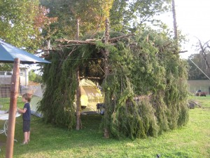
John 7.2-5: Now the Jewish feast of Tabernacles was near. ³So Jesus’ brothers advised him, “Leave here and go to Judea so your disciples may see your miracles that you are performing. ⁴For no one who seeks to make a reputation for himself does anything in secret. If you are
doing these things,
show yourself to
the world.” ⁵(For
Not even his own
brothers believed
in him.)
Image from messyanic.com

Slide 7
John 7.6-10: So Jesus replied, “My time has not yet arrived, but you are ready at any opportunity! ⁷The world cannot hate you, but it hates me, because I am testifying about it that its deeds are evil. ⁸You go up to the feast yourselves. I am not going up to this feast [with you] because my time has not yet fully arrived.” ⁹When he had
said this, he remained
in Galilee. ¹⁰But when
his brothers had gone
up to the feast, then
Jesus himself also went
up, not openly but in
secret.

Slide 8
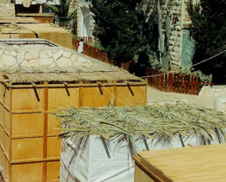
John 7.11-13: So the Jewish leaders were looking for him at the feast, asking, “Where is he?” ¹² There was a lot of grumbling about him among the crowds. Some were saying, “He is a good man,” but others, “He deceives the common people.” ¹³ However, no one spoke openly
about him for fear
of the Jewish leaders.
Image from educationscotland.gov.uk

Slide 9
John 7.14-15: When the feast was half over, Jesus went up to the temple courts and began to teach. ¹⁵Then the Jewish leaders were astonished and said, “How does this man know so much when he has never had formal instruction?”

Slide 10
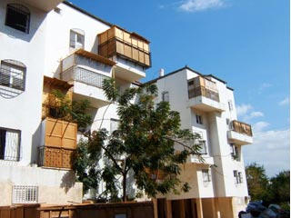
John 7.16-19: So Jesus replied, “My teaching is not from me, but from the one who sent me. ¹⁷If anyone wants to do God's will, he will know about my teaching, whether it is from God or whether I speak from my own authority. ¹⁸The person who speaks on his own authority desires to receive honor for himself; the one who desires the honor of the one who sent him is a man of
integrity, and there is no
unrighteousness in him.
¹⁹Hasn't Moses given you
the law? Yet not one of
you keeps the law! Why
do you want to kill me?”
Image from cbn.com

Slide 11
John 7.20-24: The crowd answered, “You're possessed by a demon! Who is trying to kill you?” ²¹Jesus replied, “I performed one miracle and you are all amazed. ²²However, because Moses gave you the practice of circumcision (not that it came from Moses, but from the forefathers), you circumcise a male child on the Sabbath. ²³But if a male child is circumcised on the Sabbath so that the law of Moses is not broken, why are you angry with me because I made a man completely well on
the Sabbath? ²⁴Do not judge
according to external appearance,
but judge with proper judgment.”

Slide 12
John 7.25-27: Then some of the residents of Jerusalem began to say, “Isn't this the man they are trying to kill? ²⁶Yet here he is, speaking publicly, and they are saying nothing to him. Do the rulers really know that this man is the Christ? ²⁷But we know where this man comes from. Whenever the Christ comes, no one will know where he comes from.”

Slide 13
John 7.25-27: Then some of the residents of Jerusalem began to say, “Isn't this the man they are trying to kill? ²⁶Yet here he is, speaking publicly, and they are saying nothing to him. Do the rulers really know that this man is the Christ? ²⁷But we know where this man comes from. Whenever the Christ comes, no one will know where he comes from.”
Malachi 3.1 NIV: “‘Then suddenly the Lord [the master and judge] you are seeking will come to his temple; the messenger of the covenant, whom you desire, will come,’ says the LORD Almighty.”

Slide 14
John 7.28-29: Then Jesus, while teaching in the temple courts, cried out, “You both know me and know where I come from! And I have not come on my own initiative, but the one who sent me is true. You do not know him, ²⁹but I know him, because I have come from him
and he sent me.”

Slide 15
John 7.30-32: So then they tried to seize Jesus, but no one laid a hand on him, because his time had not yet come. ³¹Yet many of the crowd believed in him and said, “Whenever the Christ comes, he won't perform more miraculous signs than this man did, will he?” ³²The Pharisees heard the crowd murmuring these things
about Jesus, so the
chief priests and the
Pharisees sent officers
to arrest him.

Slide 16
John 7.33-36: Then Jesus said, “I will be with you for only a little while longer, and then I am going to the one who sent me. ³⁴You will look for me but will not find me, and where I am you cannot come.” ³⁵Then the Jewish leaders said to one another, “Where is he going to go that we cannot find him? He is not going to go to the Jewish people dispersed among the Greeks and teach the Greeks, is he? ³⁶What did he mean by saying, ‘You
will look for me but
will not find me, and
where I am you
cannot come’?”

Slide 17
Problems…
Approaching Jesus with false assumptions
Not genuinely seeking God or his will
Superficial obedience

